Slide 1

CS10: The Beauty and Joy of Computing - Fall 2015
Lecture 1: Introduction, Abstraction
Introduction
Course Overview
Abstraction

Slide 2
We Live in the Future
“When wireless is perfectly applied the whole earth will be converted into a huge brain, which in fact it is, all things being particles of a real and rhythmic whole. We shall be able to communicate with one another instantly, irrespective of distance. Not only this, but through television and telephony we shall see and hear one another as perfectly as though we were face to face, despite intervening distances of thousands of miles; and the instruments through which we shall be able to do this will be amazingly simple compared with our present telephone. A man will be able to carry one in his vest pocket.
We shall be able to witness and hear events--the inauguration of a President, the playing of a world series game, the havoc of an earthquake or the terror of a battle--just as though we were present.”
- Nikola Tesla, “When Woman Is Boss”, Colliers Magazine, 1926

Slide 3
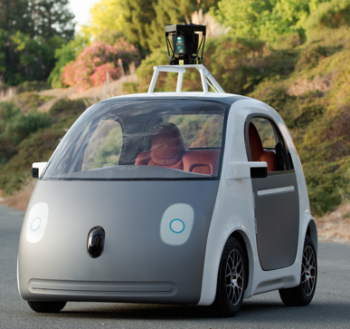
Why Study CS?
Massive impact on our lives and society as a whole.
Increasingly useful for all fields of study and areas of employment.
Beautiful mathematics and ideas.

Slide 4
Course Overview

Slide 5
Course Staff
Instructor: Josh Hug (me) hug@cs.berkeley.edu 779 Soda
GSIs:
Carlos Flores Joseph Cawthorne
Arany Uthayakumar Andy Schmitt
Adam Kuphaldt Rachel Huang
Steven Traversi Victoria Shi
Janna Golden Alex McKinney
Amruta Yelamanchili Claire Watanabe
Erik Dahlquist
(Or just Carjorandy Adarastevijannalex Amrutaclairek for short)

Slide 6
Who Are You Guys?

Slide 7
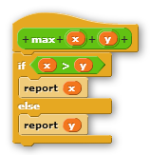
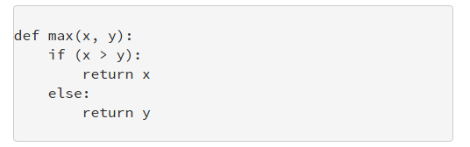
The Snap! and Python Programming Languages
Snap!: Super easy to learn. Exactly as powerful as Python.
Python: Harder to learn. Faster to use for experts. Wildly popular in real world.

Slide 8
BJC Topics
Big Ideas of Programming:
Abstraction
Algorithms (2)
Recursion (2)
Functions-as-data (2)
Programming paradigms
Cloud computing
Beauty and Joy
“CS Unplugged” activities
Lab work in pairs
“Creation” project (of your own choice)
“Explore” project (of your own choice)
Big Ideas of Computing:
How the internet works
Research summaries
The power of data (big, small)
Social implications of computing
Saving the world with computing
Cloud computing
Limits of computing
Future of computing
Robots

Slide 9
Course Websites
Course Websites:
Main site, used for everything not listed below: http://cs10.org
Discussion forums and announcements: https://piazza.com
You should be enrolled already. Click here if not.
bCourses, used only for submitting homework: https://bcourses.berkeley.edu/courses/1371647
Exam grades and regrade requests: www.gradescope.com
Syllabus including all course logistics can be found on our main website at the Course Policies link.
Next 5 slides only summarize most important policies.
Make sure to read these policies carefully! We expect you to know them.
Not quite done yet.
Will be later today.

Slide 10
Weekly Workload
Do weekly readings over weekend (or at least before lab).
No required textbook. All readings posted online.
Lectures on Monday and Wednesday (2 hours per week)
Attendance not required, but clicker questions earn EPA (see slide 12).
Lab (4 hours per week)
Attendance required for reading quizzes and lab check offs.
Discussion (1 hour per week) on Friday
Attendance not required, but can earn EPA (see slide 12).
CS10 is a demanding course, but very fun!
Weekly Readings | Lecture 1 (Monday) | Lab 1, incl. reading quiz | Lecture 2 (Wednesday) | Lab 2 | Discussion (Friday) | Homework (F/Sa/Su)
 | 1 hour | 2 hours | 1 hour | 2 hours | 1 hour

Slide 11
Goals of Each Part of the Course
Lecture: Big picture ideas. Less emphasis on programming language details.
Lab: Nuts and bolts of programming. This is where you build fundamental programming skills.
HW and Projects: Refinement of programming skills and deeper exploration of topics that most interest you.
Discussion: Discussion of big ideas and tricky concepts.
Exams: Assess big picture understanding (for both you and your transcript).

Slide 12
Lab Logistics
Reading quiz: Reflections on the readings (starting next week).
Pair Programming exercises: Will work with a partner on labs.
One person is the “driver”: Does all the typing and mousing.
One person is the “navigator”: Reviews as the other person types.
Used to great effect in both education and industry.
Lab checkoffs (starting next week):
Check-off questions: Required, covering only some of each lab.
Extra questions: To self-check your own understanding.
Experience has shown that students who complete all of the labs do better in CS10.

Slide 13
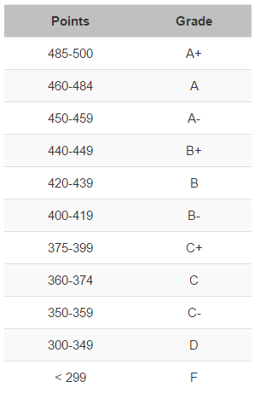
Grades and Grading
Total score is out of 500.
In-lab reading quizzes: 20
Lab checkoffs: 30
Homeworks: 10+20+30 = 60
Projects: 75+75 = 150
Exams: 25+75+100 = 200
Writing Assignment: 40
No curve. Will consider EPA for borderline grades.
E: Effort, e.g. office hours, reading Piazza
P: Participation, e.g. lecture, discussion
A: Altruism, e.g. helping others in lab or on Piazza
3 slip days. See course policies.
More details later.

Slide 14
Waitlist
We will not be adding additional sections, but anticipate being able to accommodate everyone.
Drop rate for CS10 is fairly high at the start of the semester.
If you are enrolled but need a different section, don’t mess with Telebears, you’ll just end up waitlisting yourself.
Feel free to attend a different discussion or lab than the one for which you are officially registered, or if not registered, go to any lab or discussion.
Caveat: If we run out of seats in a particular discussion or lab, priority will go to those officially enrolled (even if they show up late)!

Slide 15
Logistics Questions?

Slide 16
Abstraction

Slide 17
Complexity and Abstraction
Programming is easy, so long as your programs are small.
Complexity is our enemy.
Abstraction is the key to conquering complexity.
Learning to reason using the most appropriate abstraction is a key goal of CS10, CS61A, CS61B, CS61C, and beyond.

Slide 18
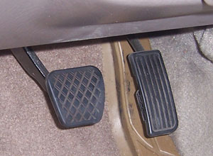
Abstraction Allows Us to Hide Unnecessary Details
Abstraction:
Detail Removal: Hide unnecessary details from users.
Detail Removal Example:
Modern user interface: Right pedal is “accelerate”, left is “decelerate”
Even as underlying technology has changed, this abstraction has not!
Computer controlled fuel injection.
Anti-lock brakes (ABS).
Would have been bad design to add more controls!
e.g. nobody wants an ABS control knob!

Slide 19
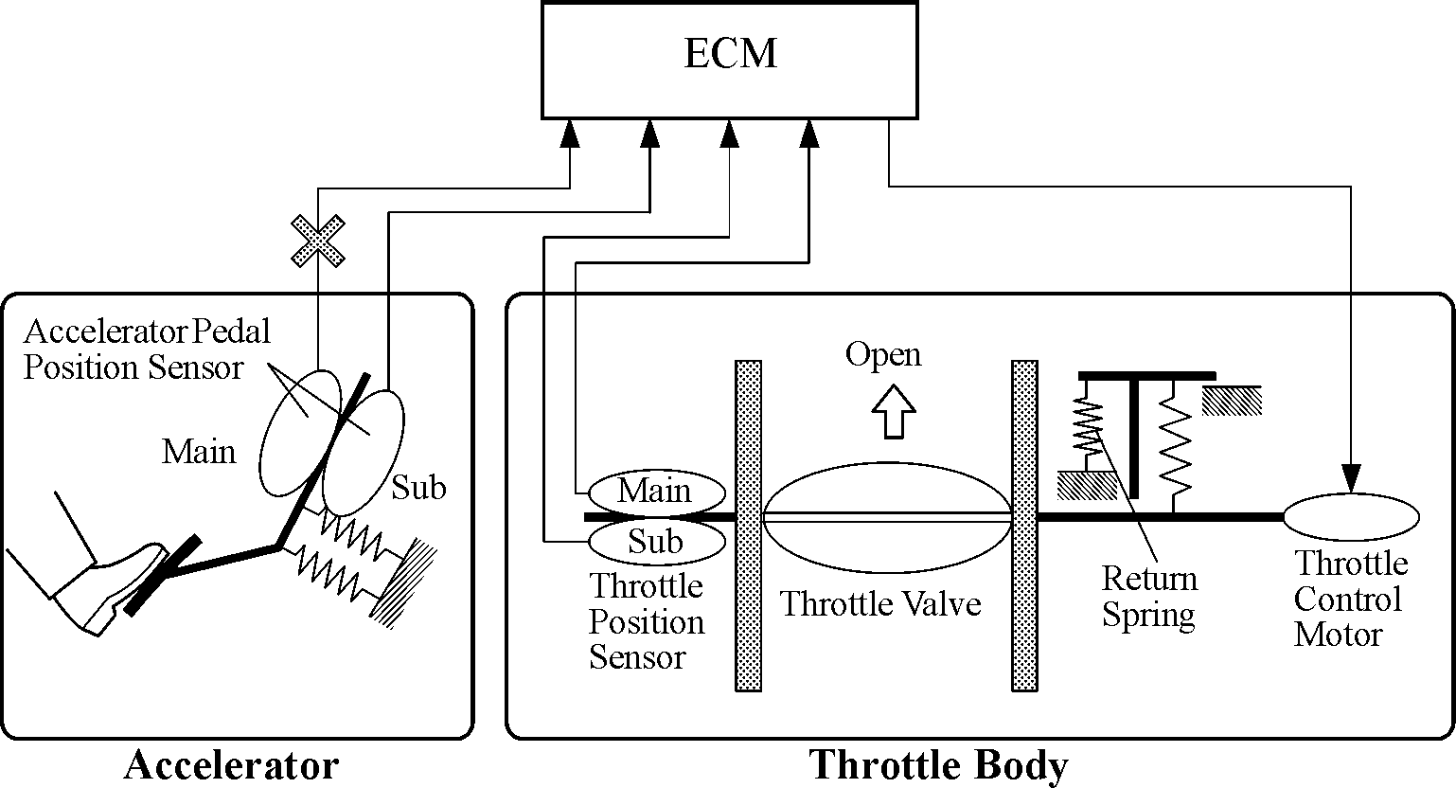
Abstraction: Allows Us to Hide Unnecessary Details
Abstraction:
Detail Removal: Hide unnecessary details from other designers.
e.g. Engine Control Module designer doesn’t care about the return spring inside the Throttle.

Slide 20
Abstraction: Allows Us to Hide Unnecessary Details
Abstraction:
Detail Removal: Hide unnecessary details from other designers.
e.g. Engine Control Module designer doesn’t care about the return spring inside the Throttle.
Nice to be able to think of a system as a hierarchy of well defined “chunks” with precise functionality. In CS, we say that we have a separation of concerns.
Engine Control Module
Accelerator
Throttle

Slide 21
Abstraction: Allows Us to Build General Purpose Artifacts
Abstraction:
Detail Removal: Hide unnecessary details from users and designers.
Generalization: Avoid unnecessary repetitive work.
Generalization Example:
Extensible shower rods: Can be used in nearly any shower.
Let’s see how these principles apply when we’re writing programs.
There will be MANY unfamiliar concepts during this demo. Don’t panic!

Slide 22
Our First Snap! Program: Drawing a Square
(See webcast for live demo!)

Slide 23
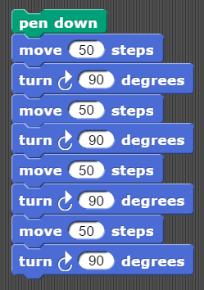
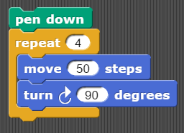

Abstraction and Snap! Sneak Preview: Drawing a Square
The following programs both draw the figure on the far right.
The program on the right makes better use of abstraction. We observe that drawing a square is just moving/turning 4 times. This saves us work.
Are any details hidden?
Note: If you’re looking at these slides online and don’t understand the programs above, this is OK. Snap will be covered in this weeks lab!

Slide 24
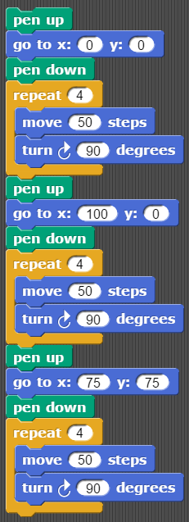
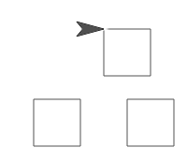
Abstraction and Snap! Sneak Preview: Drawing Three Squares
The following program draws a square at positions (0, 0), (100, 0), (75, 75).
(75, 75)
(0, 0)
(100, 0)
What is beautiful about this program? What is not?

Slide 25
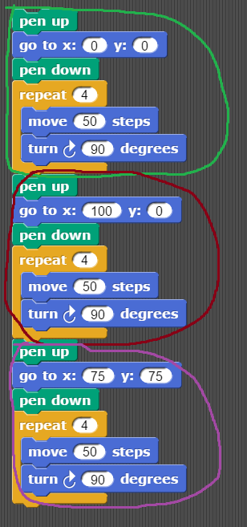
Abstraction and Snap! Sneak Preview: Drawing Three Squares
If you were designing Snap!, how would you let your programmers generalize?

Slide 26
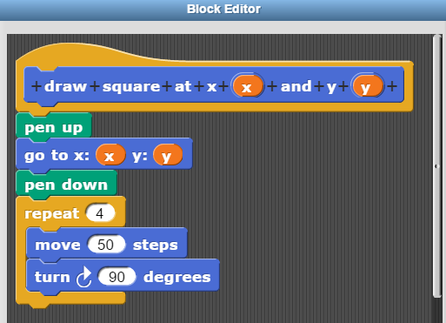

Sneak Prevew of Next Week’s Lab: Building-your-own-blocks
In Snap!, we build our own blocks.
We added a new block called “draw square at x and y”.
Details of how it works are hidden from user.
Acts as a general square drawing tool. User specifies the x and y coordinate.

Slide 27
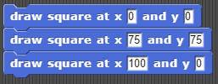
Sneak Prevew of Next Week’s Lab: Building-your-own-blocks
In Snap!, we build our own blocks. Left program is ugly. Right program is nice!

Slide 28
Parting Thoughts
One of the most important challenges in computer science:
Identifying the blocks you need to build to solve your problem.
Equivalent statement: Identifying the right abstraction that you need to solve your problem.
Personal observation: Biggest difference between weak and strong programmers in 61B is the ability to do this!

Slide 29
Lab This Week
Make sure to go to your SECOND scheduled lab of the week this week.
Example: If your labs are M/W, go to your Wednesday lab.
Example 2: If you labs are W/F, go to your Friday lab.
Lab will cover many important ideas not discussed in lecture! Lecture will focus more on the big picture, not Snap! minutiae.
Snap! language details are easier to learn through your own experimentation rather than by watching me.
Reminder: Lecture today was not to teach you how to program, but to introduce you to some big ideas. You’ll gain programming familiarity during your first lab.

Slide 30
Citations
Gas and brake “padal” image from:
https://driversed.com/images/v2008coursecontent/brakepadal.jpg
Detailed car internals block diagram image from: http://cheapautopartsdiscount.pridebike.ru/toyota-4runner-2003/srm3_files/srm3-1.png
Self driving car image from The Guardian: http://www.theguardian.com/technology/2014/may/28/google-self-driving-car-how-does-it-work
Lecture structure adapted from Dan Garcia, Brian Harvey, and Gerald Friedland.

